Slide 1
Transforming steering controls to self driving
Week 3 report
Hongshuo Wang
Professor Siu Ling Leung

Slide 2
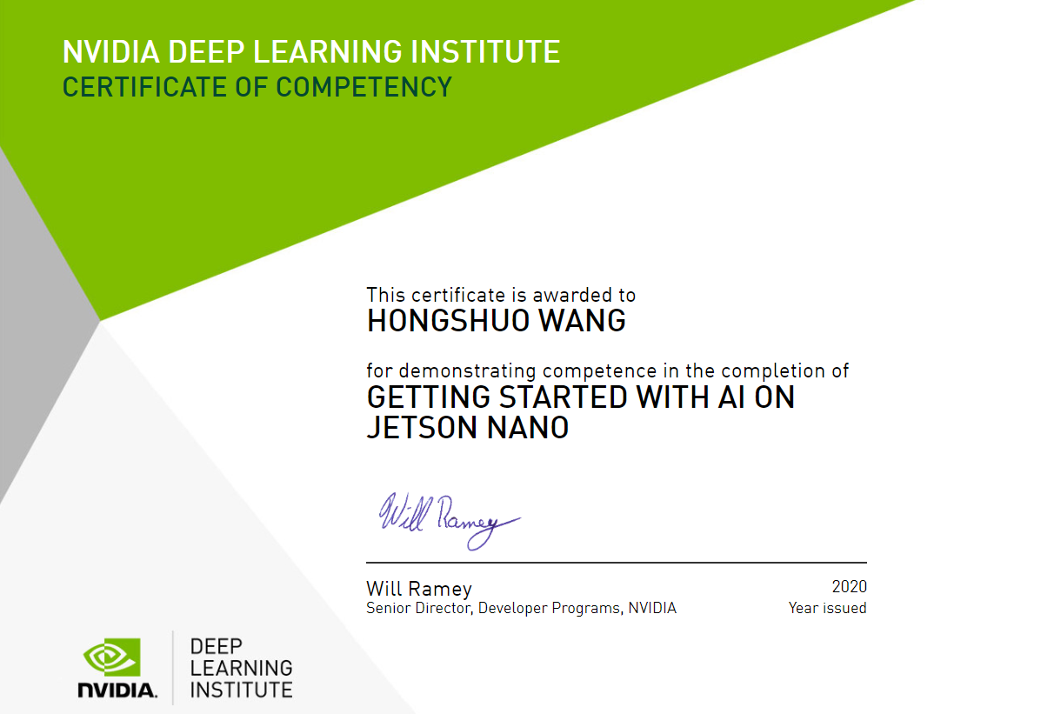

Slide 3
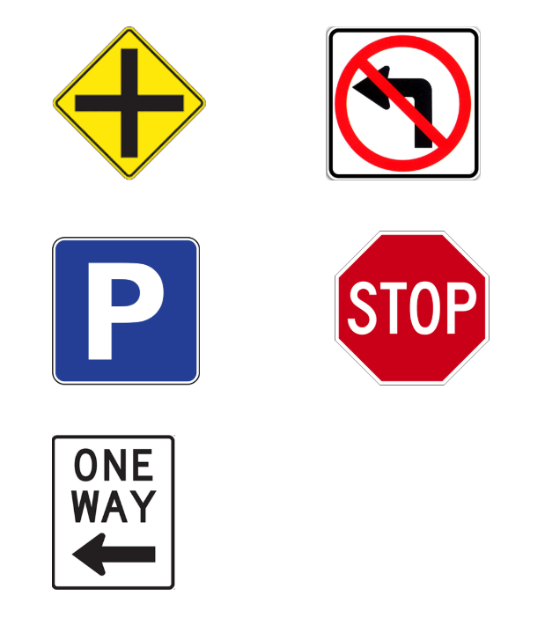
Training traffic signs
Size 2.2’’ x 2.2’’
Traffic Signs:
stop
Intersection
no left turn
one way
parking

Slide 4
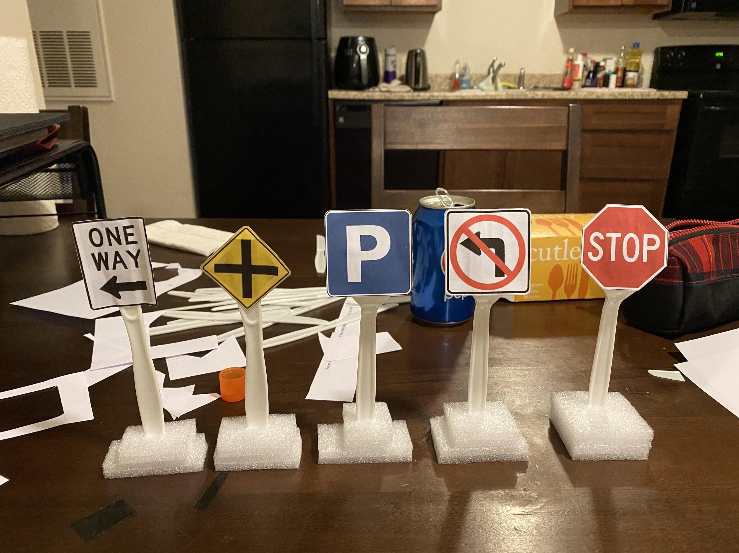
Preparation: Design Traffic Signs
Made by:
Plastic forks & knives
Tape
Paper
Foam plastic

Slide 5
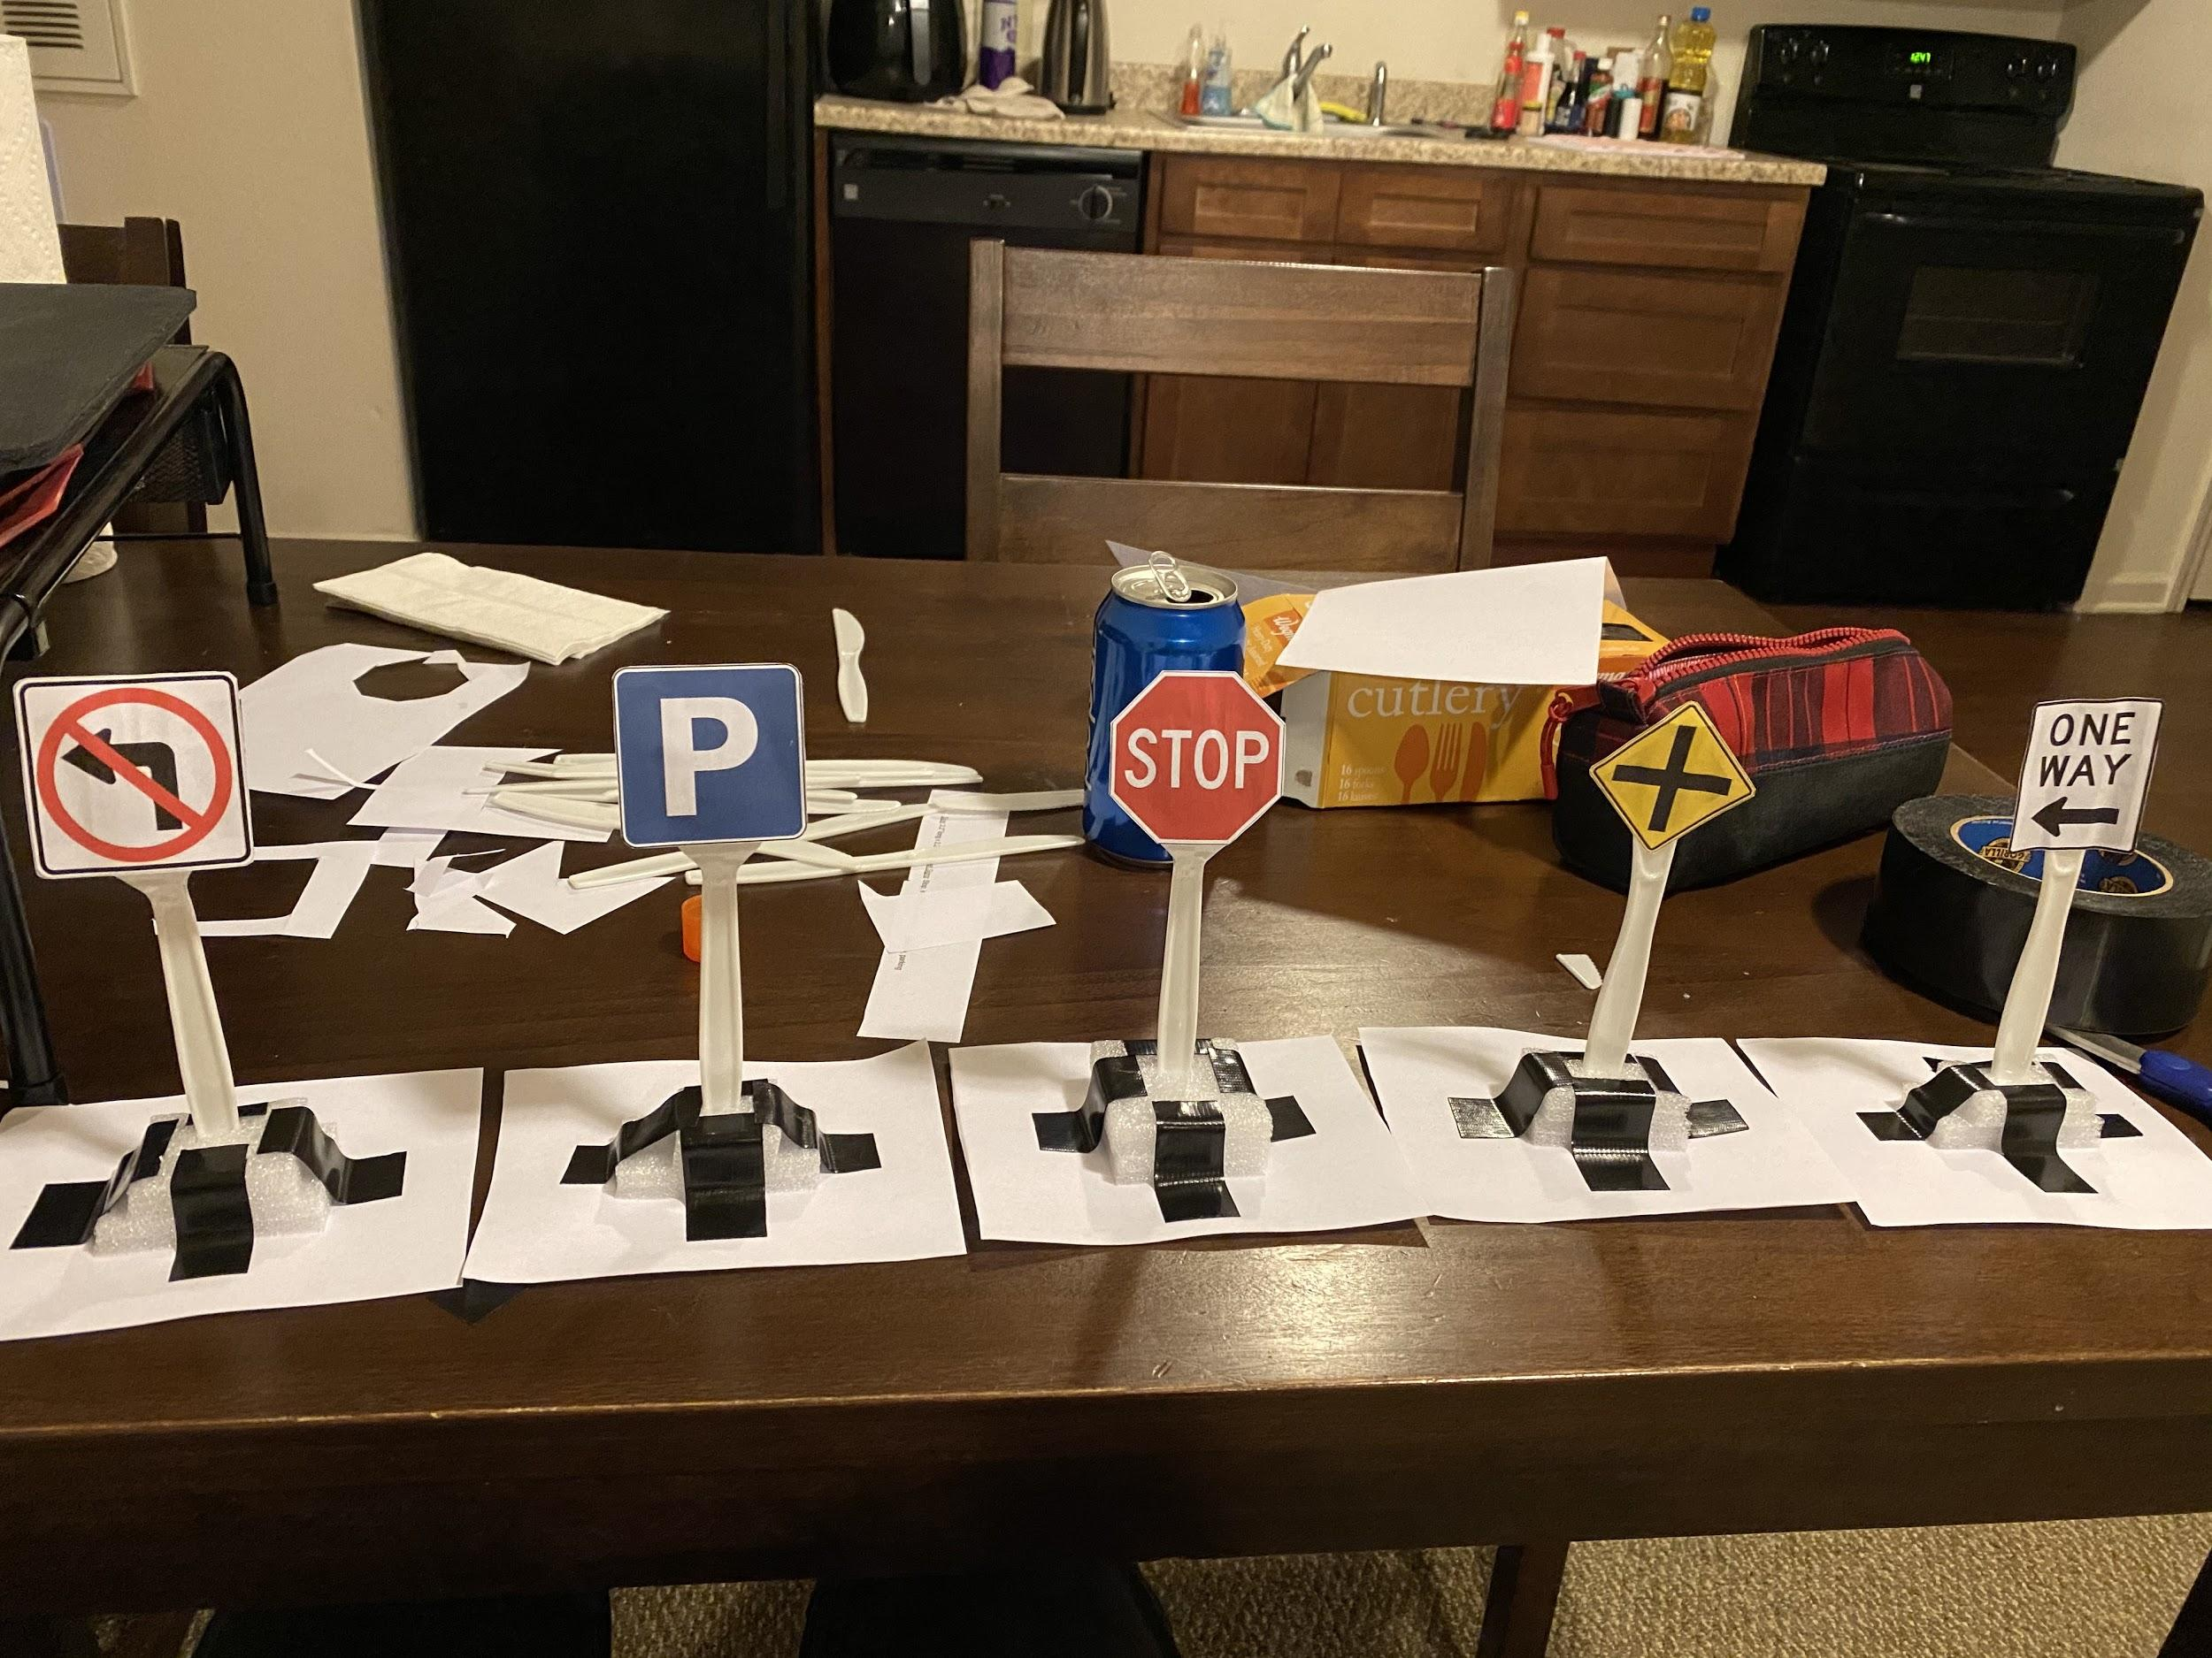
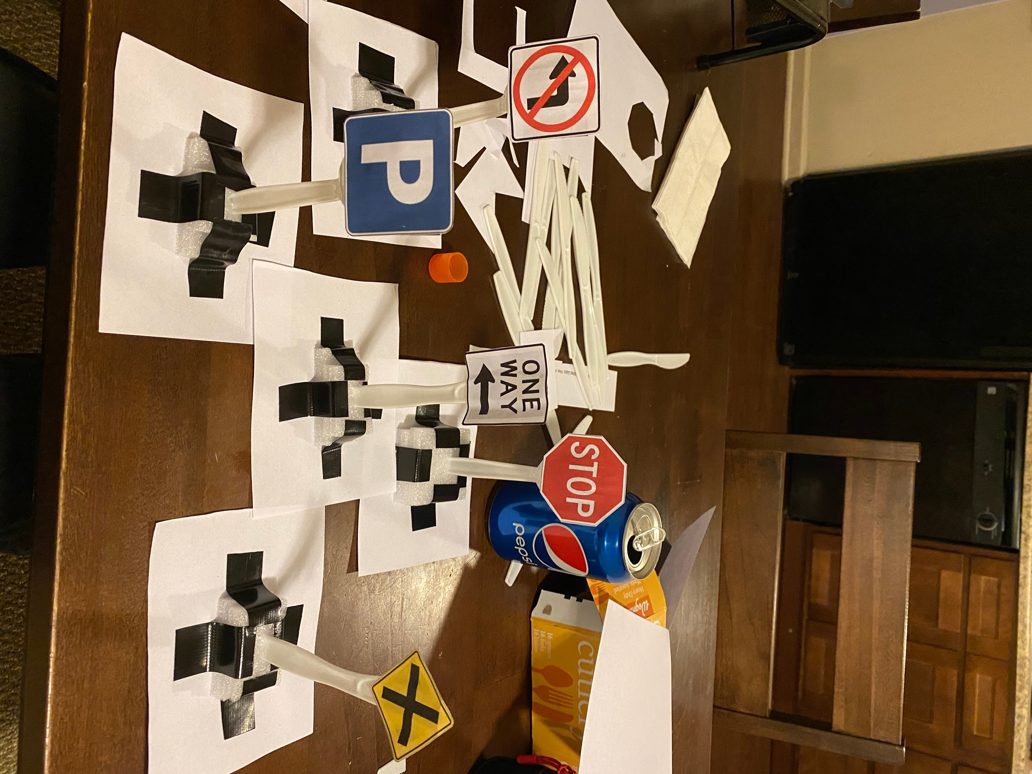

Slide 6
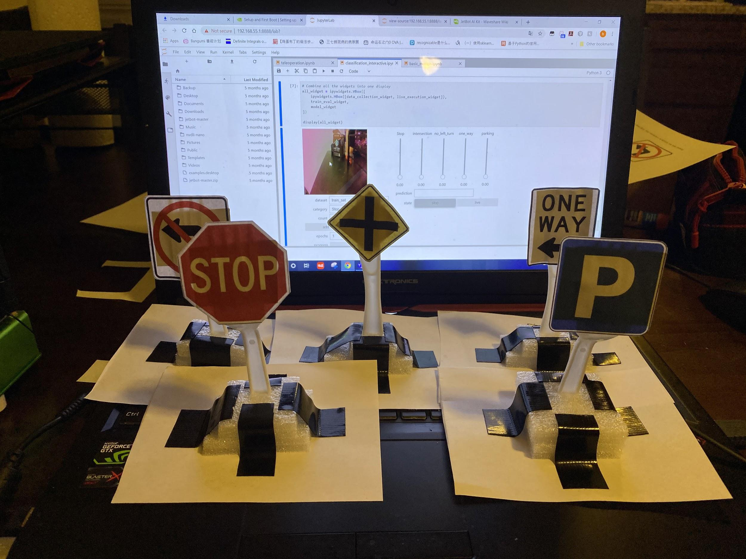
Size
Equal Height
Equal area of bottoms
Equal size of signs

Slide 7
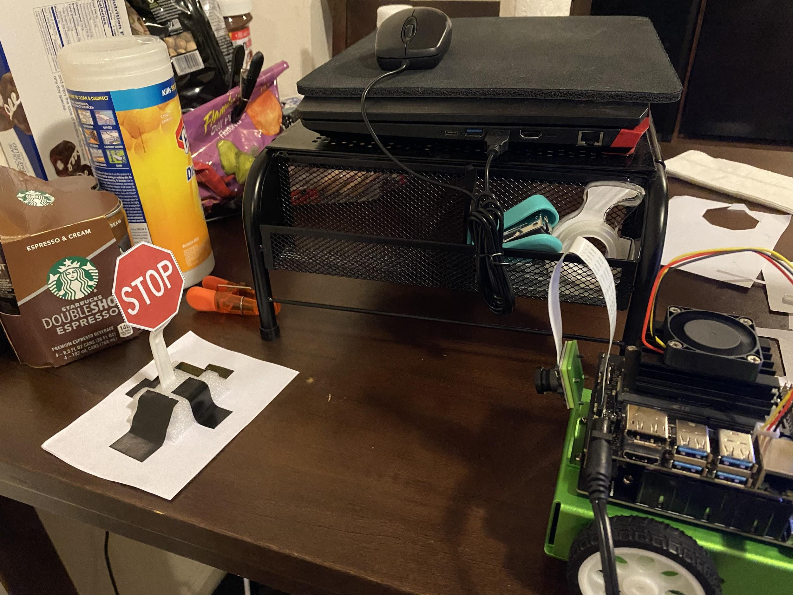
Create Training Sets
Each time:
Put the sign on the ground
Drive car to move forward or backward to the sign
Using teleoperation.ipynb
(Using the default controller to control the jetbot and take the screen shoot)

Slide 8
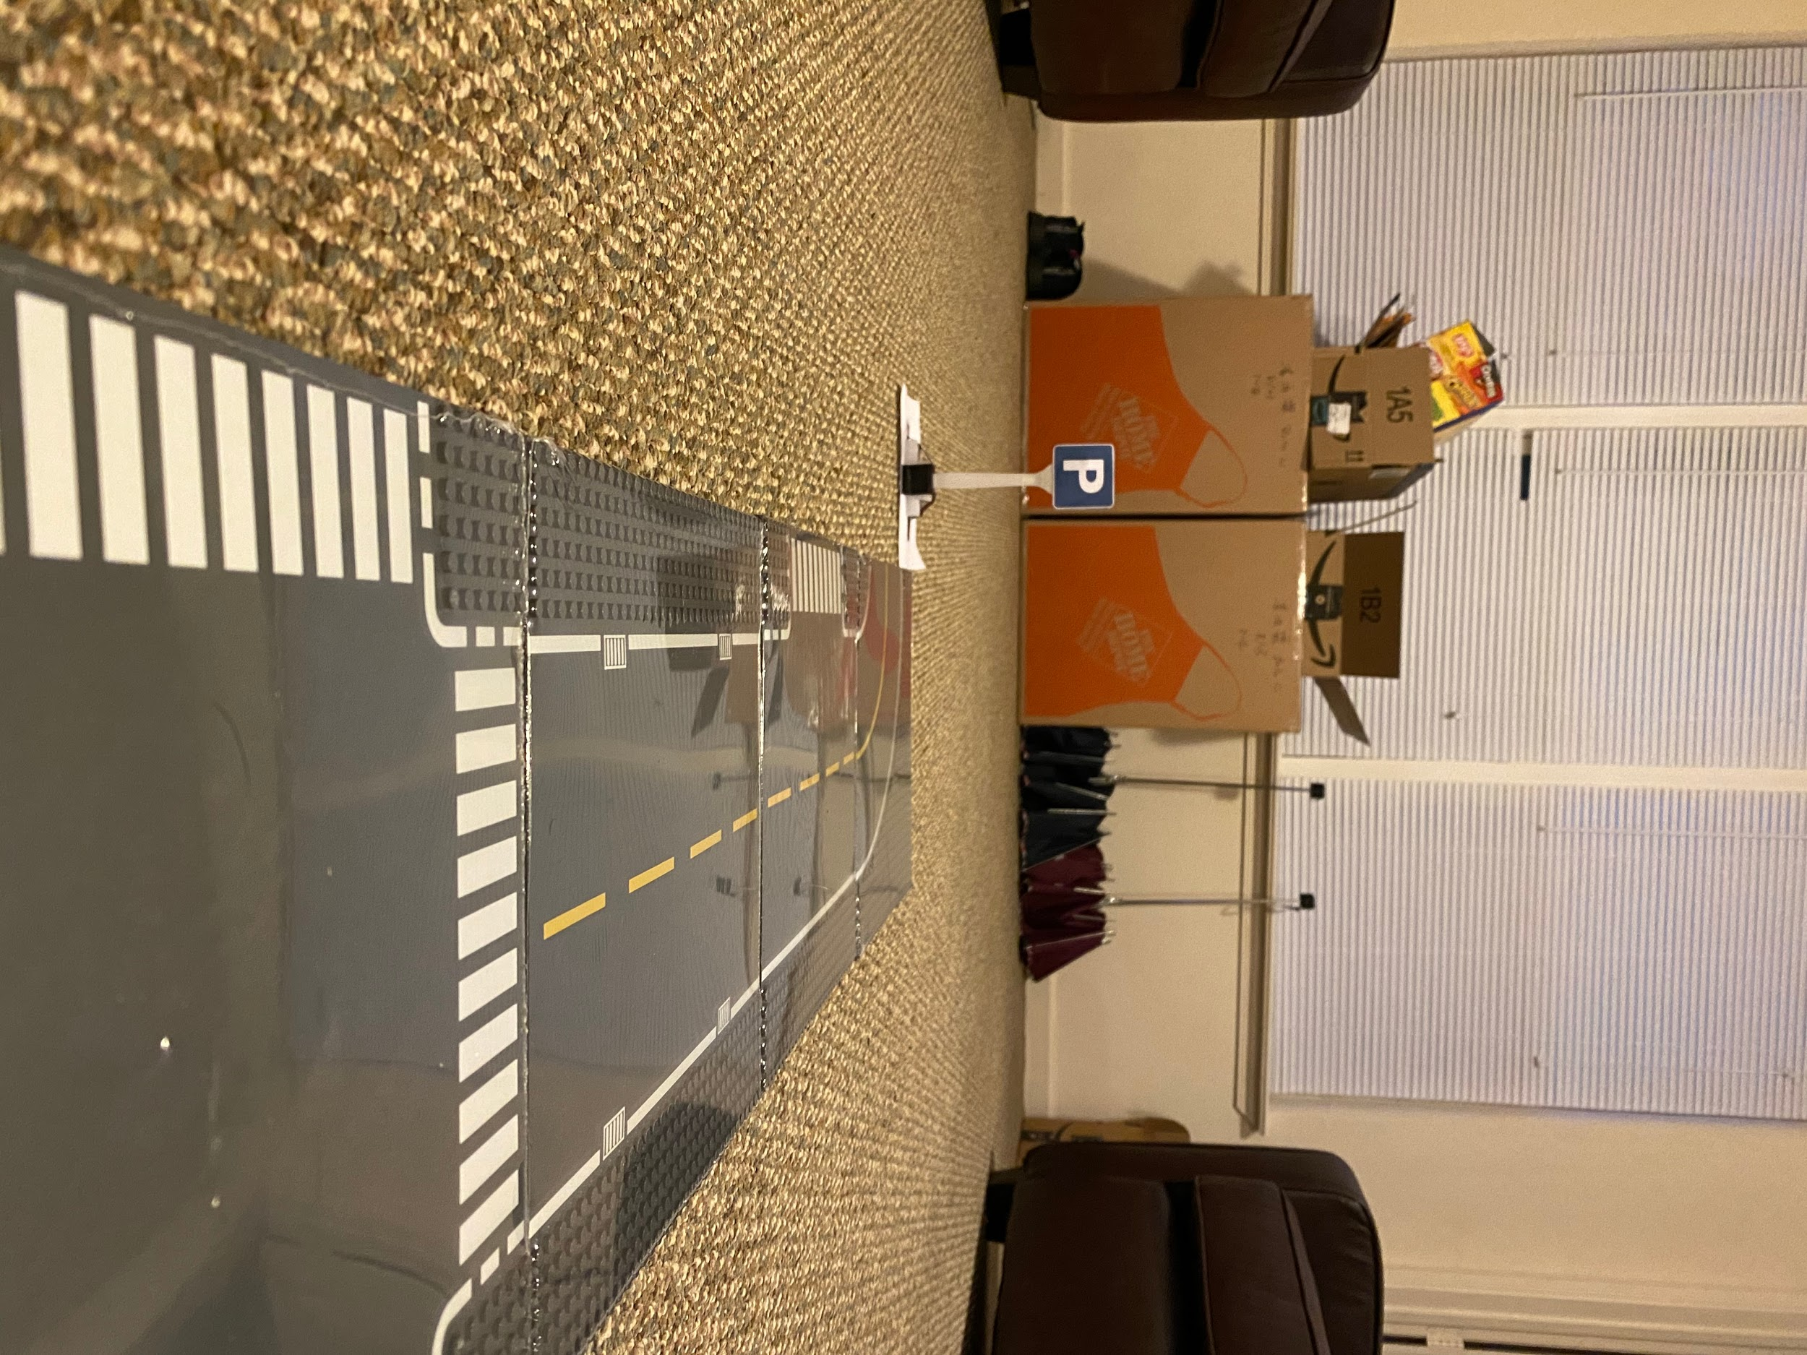
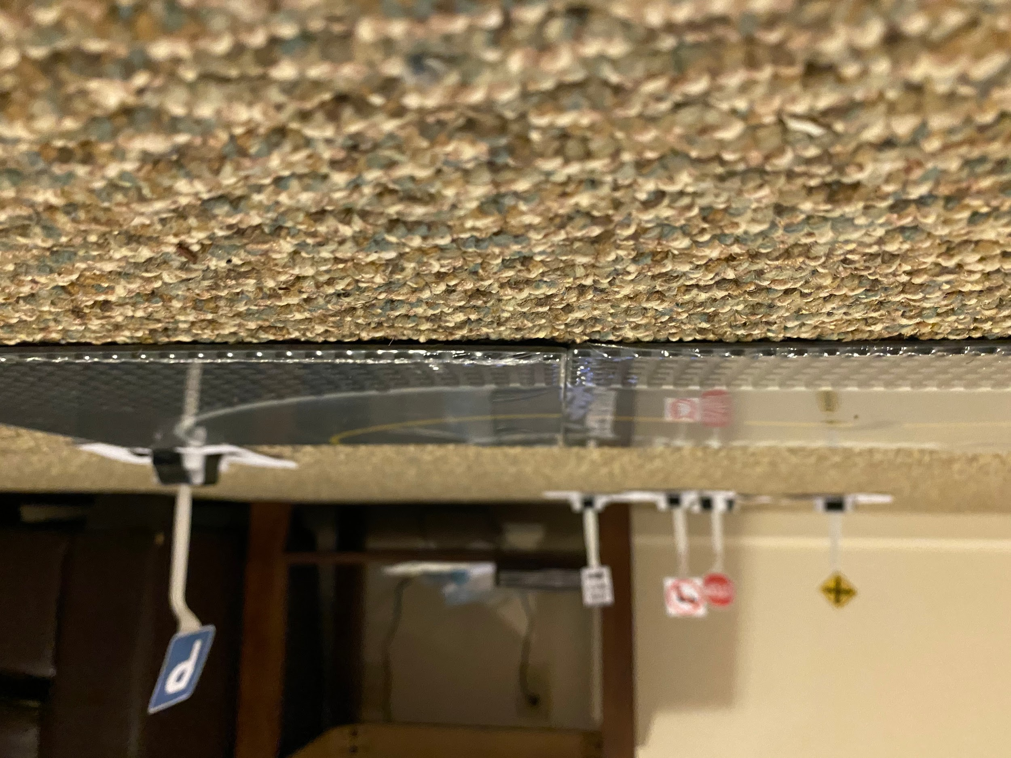

Slide 9
Training
Fine tune classification_interactive
Epoch: 20
Pretrained model:
RESNET 34
Optimizer: (sgd) Stochastic gradient descent
60 images per class

Slide 10
Training Video

